Slide 1

Using Colors Effectively in
Graphical Design
Mario Čagalj
University of Split
12.12.2012.
Based on ‘Designing with the Mind in Mind’ by Jeff Johnson and ‘The Non-Designer's Design Book: Design and Typographic Principles for the Visual Novice’ by Robin Williams

Slide 2

Introduction
Color is a powerful (visual) communication meduim
  shapes our perception, interpretetion and memory or what we see
  it can enhance the effectiveness of a message
  likewise, it may imapir it
Human color perception has both strengths and limitations
  vision optimized to detect contrast (edges, recall CARP), not absolute brightness
  our ability to distinguish colors depends on how colors are presented
  color-blindeness
  the user’s display and the enviromental conditions affect color perception

Slide 3
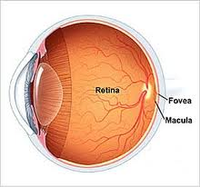
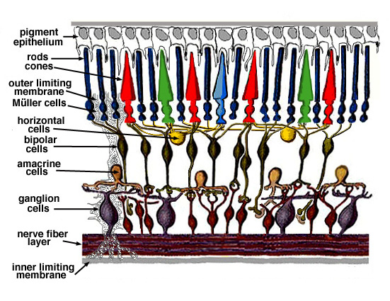
How Color Vision Works?
An eye focuses light on the retina at the back of the eye
Retina has two types of light photoreceptor cells
  rods – detect light levels (brightness) but not colors
  cones – detect colors
    sensitive to red light
    sensitive to green light
    sensitive to blue light
  other colors detected through different
  combinations of RGB

Slide 4
How Color Vision Works?
Most of the time, our vision is based entirely on input from our cones
  rods are barely used (only in poorly lighted enviroments)
    dinner by candlelight
    dark house
    camping outside after dark
    ...
  those who live in modern
  (industrialized) societies
  hardly use their rods at all

Slide 5
How Color Vision Works?
The relative quantities of the three cone types are in the ratio red:green:blue = 40:20:1
  the eye’s overall sensitivity to b is much lower than to r and g

Slide 6
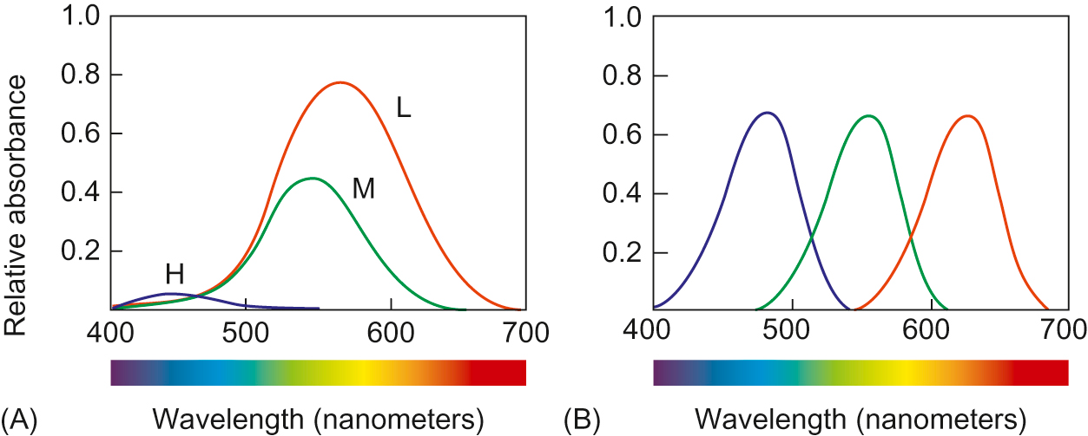
How Color Vision Works?
Color-sensitive photoreceptors (cones) are sensitive to wider range of light frequencies
  their sensitivity ranges overlap considerably
  their sensitivity differs considerably
retinal receptors
artifitial RGB receptors

Slide 7
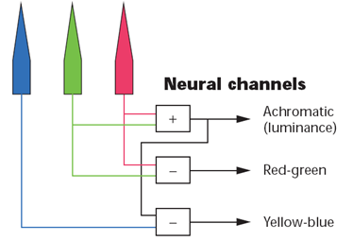
How Color Vision Works?
How do we see a broad range of colors?
  our brain combines the signals from the cones by subtraction
    the 3 cones overlap in the wavelengths of light to which they respond, so it is more efficient for the visual system to record differences between the responses of cones, rather than each type of cone's individual response
  neurons in the visual cortex (at the back of our brain)
    subtract the signals coming over the optic nerves from the green (medium- ) and red (low-frequency) cones, producing ‘red-green’ difference signal
    subtract the signals from the high- and low-frequency cones, yielding a ‘yellow-blue’ difference signal channel
    finally, a third group of neurons adds the signals
    coming from the low- and medium-frequency
    cones to produce an overall luminance
    (or ‘black-white’) signal channel
  these 3 channels are called
  color-opponent channels

Slide 8

Vision is Optimized for Edge Contrast
Not Brightness
Oponnent color process (subtractions) make our visual system much more sensitive to differences in color and brightness (edge contrast) than to absolute brightness levels
  Compare the two circles: are they the same?
    they are exacty the same (the size and the color shade)
    demonstrates insensitivity to absolute brightness

Slide 9
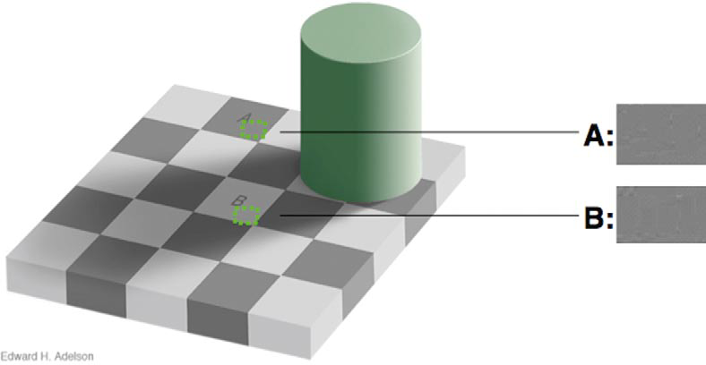
Vision is Optimized for Edge Contrast
Not Brightness
Insensitivity to brightness and sensitivity to contrast by E. H. Adelson
The squares marked A and B are the same gray. We see B as white because it is “shaded” by the cylinder! (check with an eyedropper)

Slide 10
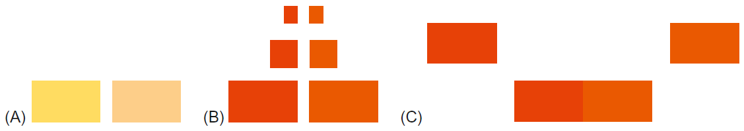
Ability to Discriminate Colors
Depends on how Colors are Presented
Even our ability to detect color differences is limited
Three presentation factors affect our ability to distinguish colors from each other
  Paleness: The paler (less saturated) two colors are, the harder is to tell them apart
  Color patch size: The smaller or thinner objects are, the harder it is to distinguish their colors
  Separation: The more separated color patches are, the more difficult it is to distinguish their colors, especially if the separation is great enough to require eye motion between patches

Slide 11


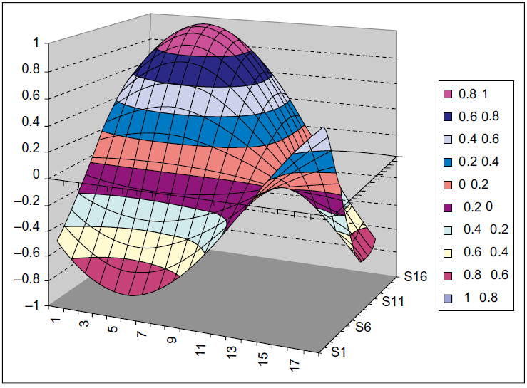
Limited Ability to Discriminate
Old ITN.net site use two pale colors (white and pale yellow) to indicate the current step in the reservation process
Tiny color patches hard to distinguish

Slide 12
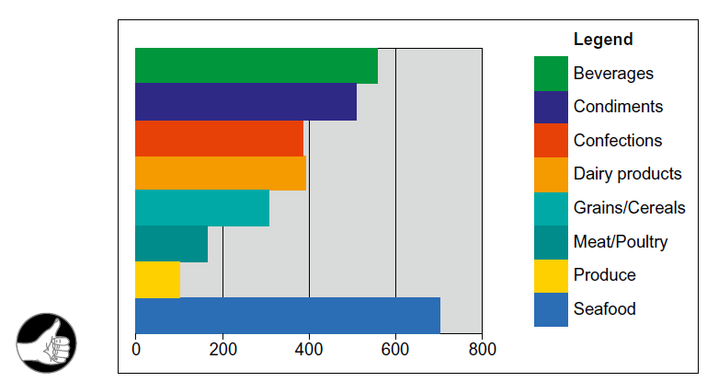
Limited Ability to Discriminate
Large color patches make it easier to distinguish the colors

Slide 13
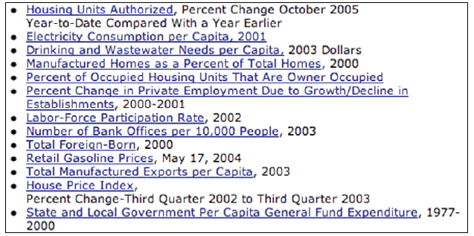
Limited Ability to Discriminate
Color contrast between visited and unvisited links too subtle
Moreover, two shades of blue color used
  the color range in which our eyes are least sensitive

Slide 14
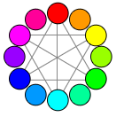
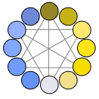
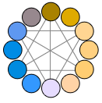
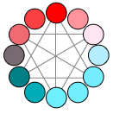
Color-blindness
Note:
Color blindness
http://www.iamcal.com/toys/colors
Being color-blind does not mean seeing grey or black and white
It means that one or more ‘color subtraction channels’ do not function normally
  It becomes difficult to distinguish certain pairs of colors
Approximatelly 8% of male and around 0.5% female population suffer some form of color-blindness
  The most common type of colorblindness is red/green
  This means that your boss or even worse your investor is potentially affected
normal color vision (1% of male population) (6% of male population) (1% of male population)
http://msdn.microsoft.com/en-us/library/windows/desktop/aa511283.aspx

Slide 15
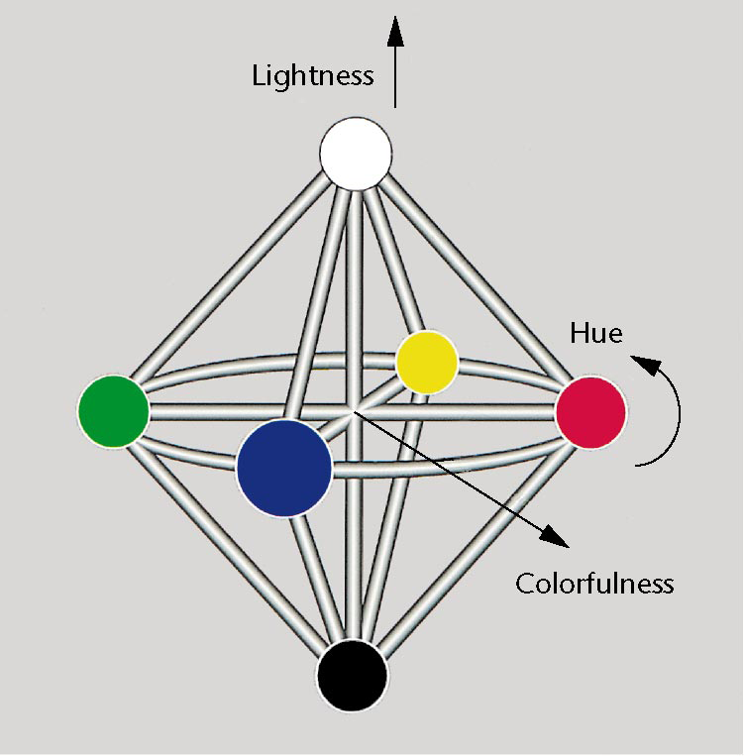
Perceptual Color Model
Edward Hering (1892)
German psyhologist E. Hering proposed a system of 6 elementary colors arranged in three opponent pairs as a basis of color perception (opponent color theory)
  white – black
  red – green
  blue – yellow
  The above colors are opposed in the
  sense that no one would describe
  a particular color
    whitish-black
    reddish-green
    bluish-yellow
This model corresponds closelly to the opponent channels
created by human retina

Slide 16
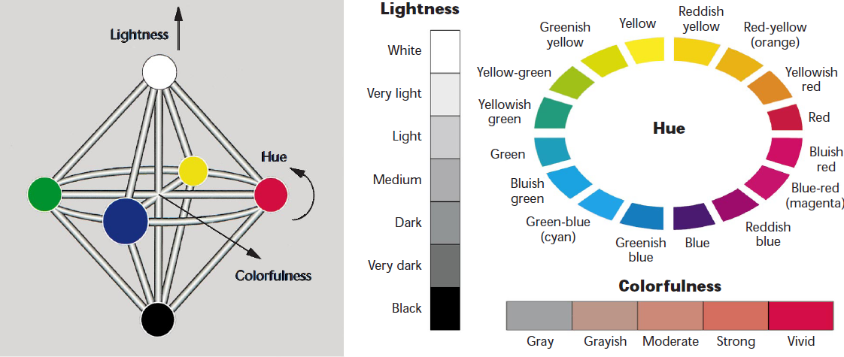
Simple Color-Naming Model
E.g., light moderate yellowish-green or strong dark blue
But not very dark strong yellow or light vivid blue

Slide 17
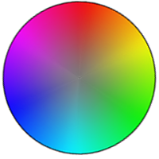
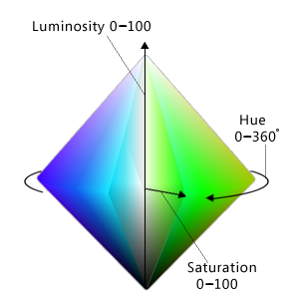
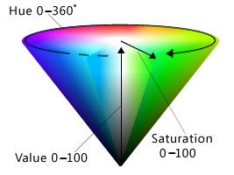
HSL/HSV color spaces
Hue, Saturation, and Luminosity or Value
Hue: The basic color in the color wheel,
ranging from 0 to 360 degrees where
both 0 and 360 degrees are red
Saturation: How pure (vs. dull) the color is,
ranging from 0 to 100, where 100 is fully
saturated and 0 is gray
Luminosity: How light the color is, ranging
from 0 to 100, where 100 is as light as possible
(white, regardless of the hue and saturation) and
0 is as dark as possible (black)
Value: How bright the color is, ranging from 0 to 100,
where 100 is as bright as possible (which is half
luminosity in the HSL space) and 0 is as dark as possible (black).

Slide 18

Some Guidelines for Using Colors
Distinguish colors by saturation and brightness as well as hue
  make sure the contrast between colors is high (but see guideline 5)
  one way to test whether colors are different enough is to view them in grayscale (if not distinguishable when rendered in grays, they aren’t different enough)
Use distinctive colors
  recall that our visual system combines the signals from retinal cone cells to produce ‘color opponent’ channels: red-green, yellow-blue, and black-white
  the collors that people distinguish most easily are those that cause a strong signal on one of the three color-perception channles, and neutral signals on the other two channels:

Slide 19
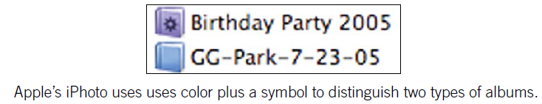

Some Guidelines for Using Colors
Avoid color pairs that color-blind people cannot distinguish
  http://www.vischeck.com
Use color redundantly with other cues
  do not rely on color alone

Slide 20

Some Guidelines for Using Colors
Separate strong opponent colors
  placing opponent colors right next to or on top of each other causes a disturbing flickering sensation

Slide 21
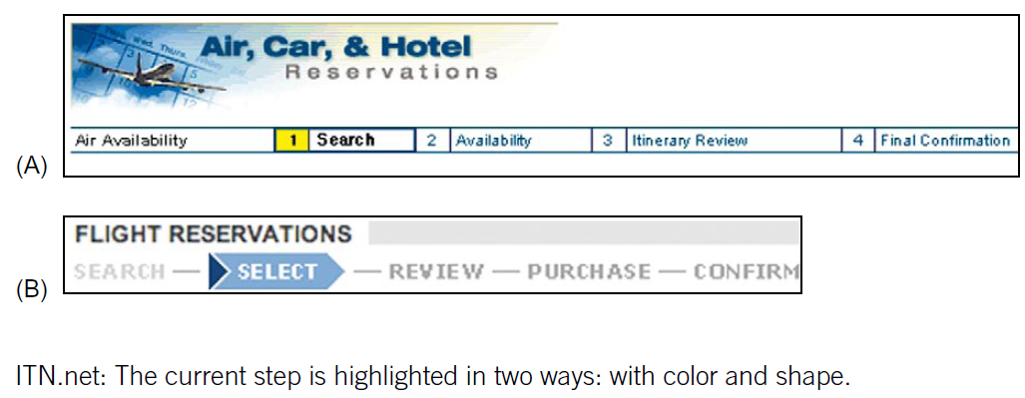
Some Good Examples

Slide 22
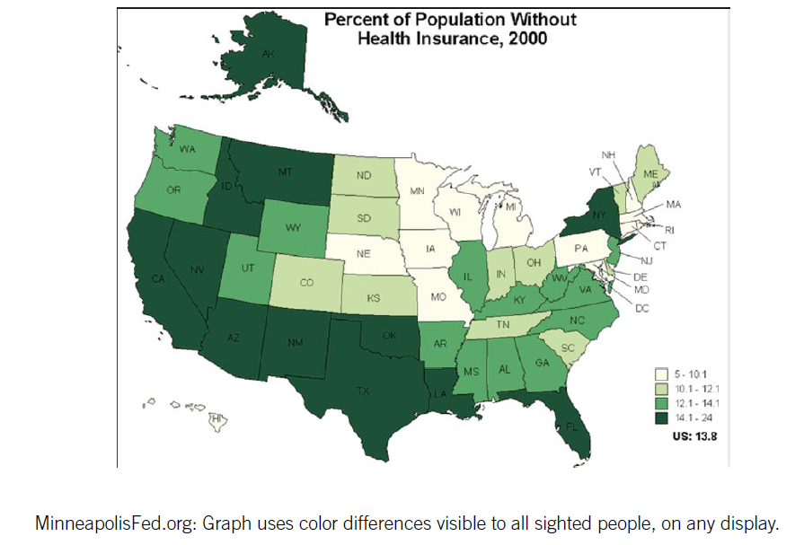
Some Good Examples

Slide 23
The Amazing Color Wheel
‘The Non-Designer’s Design-Book’ by Robin Williams

Slide 24
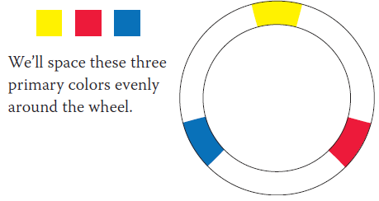
The Color Wheel
Amazingly useful when you need to make a conscious decision about choosing colors for a project
The color wheel begins with yellow, red, and blue (primary colors)
  cannot be obtained by mixing other colors

Slide 25
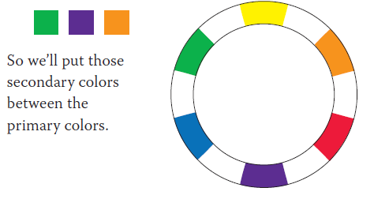
The Color Wheel
If you take your watercolor box and mix each of these colors with an equal amount of the one next to it, you’ll get the secondary colors

Slide 26
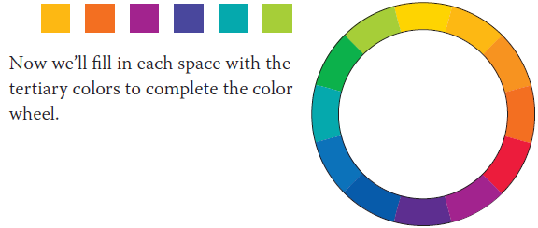
The Color Wheel
To fill in the empty spots in the color wheel, mix equal parts of the colors on each side
  these are called the tertiary (or third) colors
  yellow and orange make, well, yellow-orange,
  blue and green make blue-green (which I’ll call aqua)

Slide 27
Color Relationships
So now we have a color wheel with the basic twelve colors
With this color wheel, we can create combinations of colors that are pretty much guaranteed to work together
On the following pages, we’ll explore the various ways to do this

Slide 28
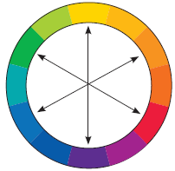
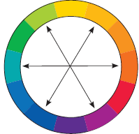

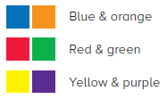
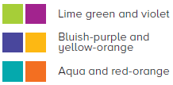
Color Relationships
Complementary
Colors directly across from each other, exact opposites, are complements
  Because they’re so opposite, they often work best when one is the main color and the other is an accent

Slide 29
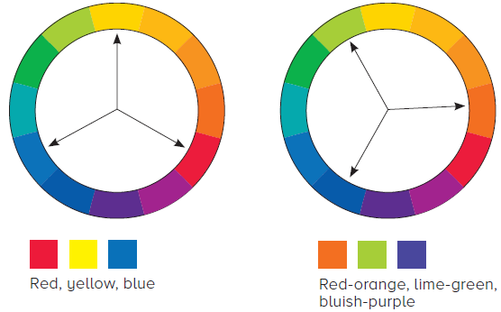
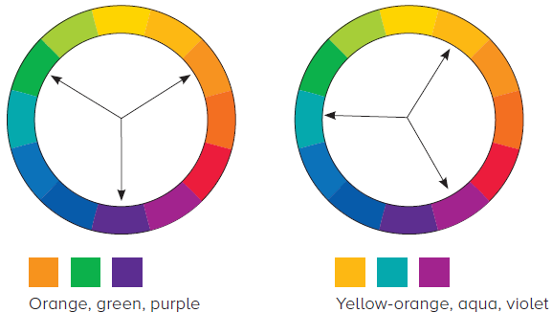
Color Relationships
Triads
A set of three colors equidistant from each other always creates a triad of pleasing colors
  Red, yellow, and blue is an extremely popular combination for children’s products - primary triad

Slide 30
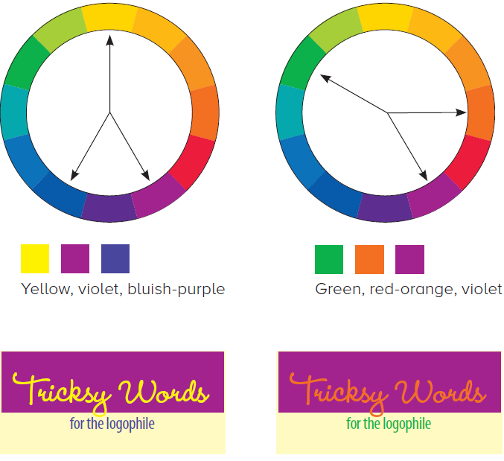
Color Relationships
Split Complement Triads
Another form of a triad is the split complement
  choose a color from one side of the wheel
  find its complement directly
  across the wheel
  use the colors on each
  side of the complement

Slide 31
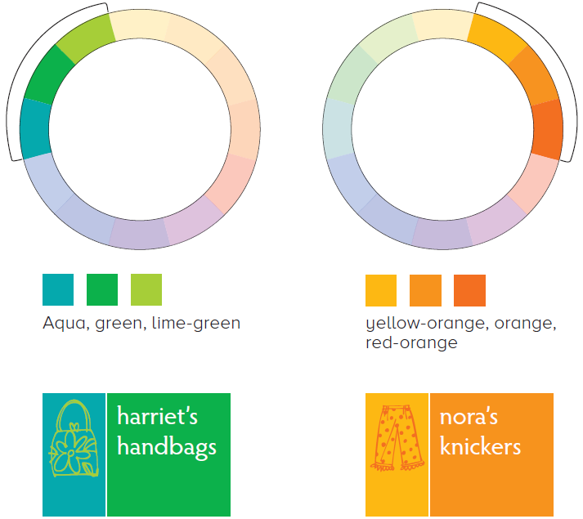
Color Relationships
Analogous Colors
An analogous combination is composed of those colors that are next to each other on the wheel
  No matter which two or
  three you combine, they all
  share an undertone of
  the same color, creating a
  harmonious combination

Slide 32
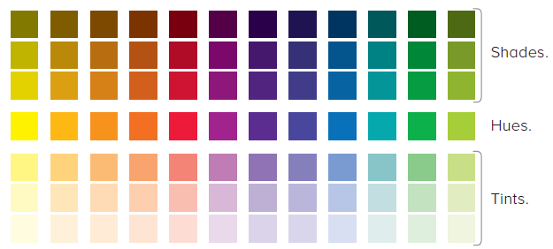
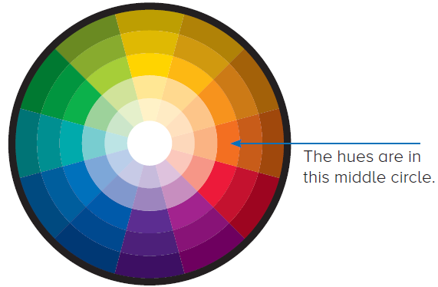
Extending the Wheel: Shades and Tints
Hue = the pure color
Shade = color + black (reduces lightness)
Tint = color + white (increases lightness)

Slide 33
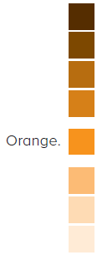


Shades and Tints
Monochromatic Colors
Combination composed of one hue with any number of its corresponding tints and shades

Slide 34
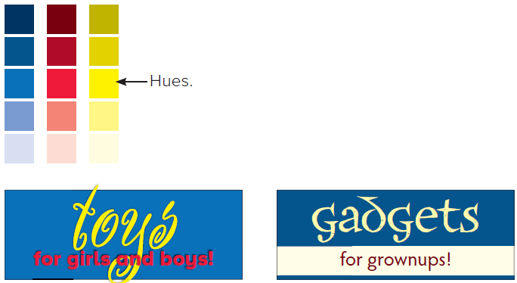
Shades and Tints
Shades and tints in combination
Choose one of the four color relationships described on ‘Color Relationships’ slides, but instead of using the hues, use various tints and shades of those colors
This expands your options tremendously, but you can still feel safe that the colors “work” together

Slide 35
Watch the Tones
Tones: colors of the same hue and lightness, but of varying saturation
Are there any colors that don’t look great together?
  Not if you subscribe to Robin’s Wildflower Theory of Color
  Have you ever seen a field of wildflowers and said, “That’s a dreadful combination of colors in that field.” Probably not.
  But what that field of wildflowers automatically includes is a variety of tones, of different values of colors
  About the only thing that is guaranteed to cause visual twitching because of color combinations is if the tones are too similar

Slide 36
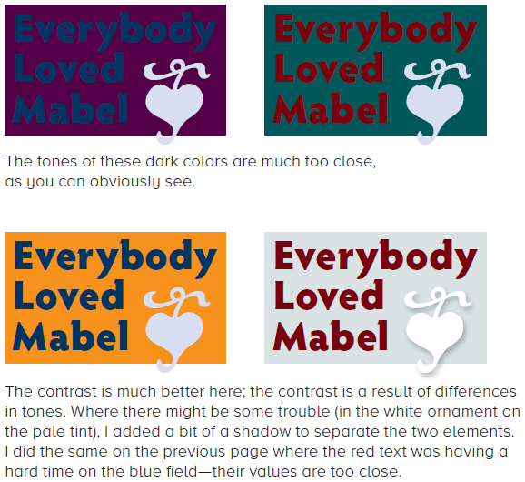
Watch the Tones

